Slide 1
Serving Impartially
Rina Grassotti
Michael Holt
Notes:
In this portion of the training, we will be exploring what it means to serve impartially, how to avoid prejudgment of a case and how to avoid bias and conflicts of interest.

Slide 2
Learning Outcomes
Understand:
How to avoid prejudging facts
How to avoid conflicts of interest
How to serve impartially and without bias
Notes:
These outcomes are derived from the regulations. 34 C.F.R. § 106.45 (b)(iii)

Slide 3
Bias and Conflict Basics
Bias and Conflict of Interests Prohibited
Avoid pre-judgment of the case
Keep an open mind and avoid stereotypes
Must uphold fairness and equity and remain impartial and objective throughout the process
Notes:
Neither the Title IX Coordinator nor any individuals designated to serve as an investigator, Hearing Officer, Appellate Officer, or informal resolution facilitator shall have a bias or conflict of interest for or against Complainants or Respondents generally or against any individual Complainant or Respondent. With the exception of advisors, anyone else who participates in the Grievance Process, such as the Dean of the School of Performance Studies, the Safety and Security Manager, the HR Manager, the President, the Director of Human Resources, or any designees, must also not have a bias or conflict of interest.
Avoid pre-judgment of the case; keep an open mind and avoid stereotypes
Must uphold fairness and equity and remain impartial and objective throughout the process

Slide 4
Considerations
Relationship with Party or witness
Preconceived notions or biases
Wearing multiple hats
Any other reason
Notes:
Bias or Conflict of Interest Considerations:
Do you have any previous or special relationship with any of the Parties or witnesses?
Do you have any preconceived notions or biases?
(Although the regulations do allow overlapping roles, it may not be a best practice; the regulations expressly prohibit decision makers (i.e., Hearing Officer and Appellate Officer) from being the same person as the Title IX Coordinator or investigator)
Is there any reason why you cannot carry out your duties fairly and in accordance with the SMR Policy?

Slide 5
Process for Bias or Conflict Concerns
Letter of concern to Title IX Coordinator (or Director of HR if concern relates to Title IX Coordinator)
Look into the matter
Make determination as to removal from role
If removed, appoint alternate
Notes:
Process for Raising and Deciding Bias or Conflict of Interest Concerns:
A Party or person appointed to serve in a role in the Grievance Process may submit a written letter of concern relating to bias or conflict of interest at any time to the Title IX Coordinator; however, if the letter of concern relates to the alleged bias or conflict of interest by the Title IX Coordinator, the Party or individual shall submit the letter to the Director of Human Resources or his or her designee.
The Title IX Coordinator or the Director of Human Resources or designee shall promptly speak with the individual alleged to have a bias or conflict of interest and conduct any other appropriate inquiry into the matter.
The Title IX Coordinator or the Director of Human Resources or designee shall make a determination as to whether the individual alleged to have a bias or conflict of shall be removed from their role.
If the individual alleged to have a bias or conflict is removed from their role, the Title IX Coordinator or the Director of Human Resources or designee shall appoint an alternate individual to serve in their place.

Slide 6
Does Bias Exist?
Fact-sensitive inquiry
Reasonable person standard
Avoid generalizations
Notes:
Determining Whether Bias Exists:
Requires an examination of the particular facts of the situation
Apply a common sense approach and reasonable person standard, i.e., whether a reasonable person would believe bias exists
Use caution to avoid generalizations that might unreasonably conclude that bias exists (e.g., assuming that all self-professed feminists, or self-described survivors, are biased against men, or that a male is incapable of being sensitive to women, or that prior work as a victim advocate, or as a defense attorney, renders the person biased against Complainants or Respondents)

Slide 7
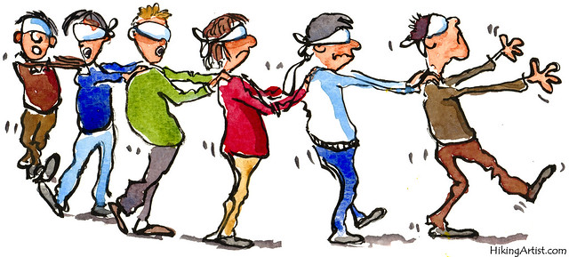
Anchoring bias. People are over-reliant on the first piece of information they hear. In a salary negotiation, whoever makes the first offer establishes a range of reasonable possibilities in each person’s mind.
Conservatism bias. Where people favor prior evidence over new evidence or information that has emerged. People were slow to accept that the Earth was round because they maintained their earlier understanding that the planet was flat.
Availability heuristic. People overestimate the importance of information that is available to them. A person might argue that smoking is not unhealthy because they know someone who lived to 100 and smoked three packs a day.
Confirmation bias. We tend to listen only to information that confirms our preconceptions – one of the many reasons it’s so hard to have an intelligent conversation about climate change.
Avoiding
Bias
Bandwagon effect. The probability of one person adopting a belief increases based on a number of people who hold that belief. This is a powerful form of groupthink and is reason why meetings are often productive.
Clustering illusion. This is the tendency to see patterns in random events. It is key to various gambling fallacies, like the idea that red is more or less likely to turn up.
Blind-spot bias. Failing to recognize your own cognitive biases is a bias in itself. People notice cognitive and motivational biases much more in others than in themselves.
Choice-supportive bias. When you choose something, you tend to feel positive about it, even if that choice has flaws. Like how you think your dog is awesome – even if it bites people every once in a while.
This Photo by Unknown Author is licensed under CC BY-NC

Slide 8
Coming Up
Evidence issues

